Slide 1
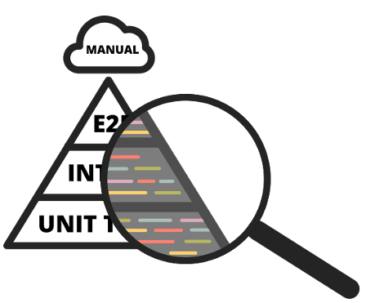
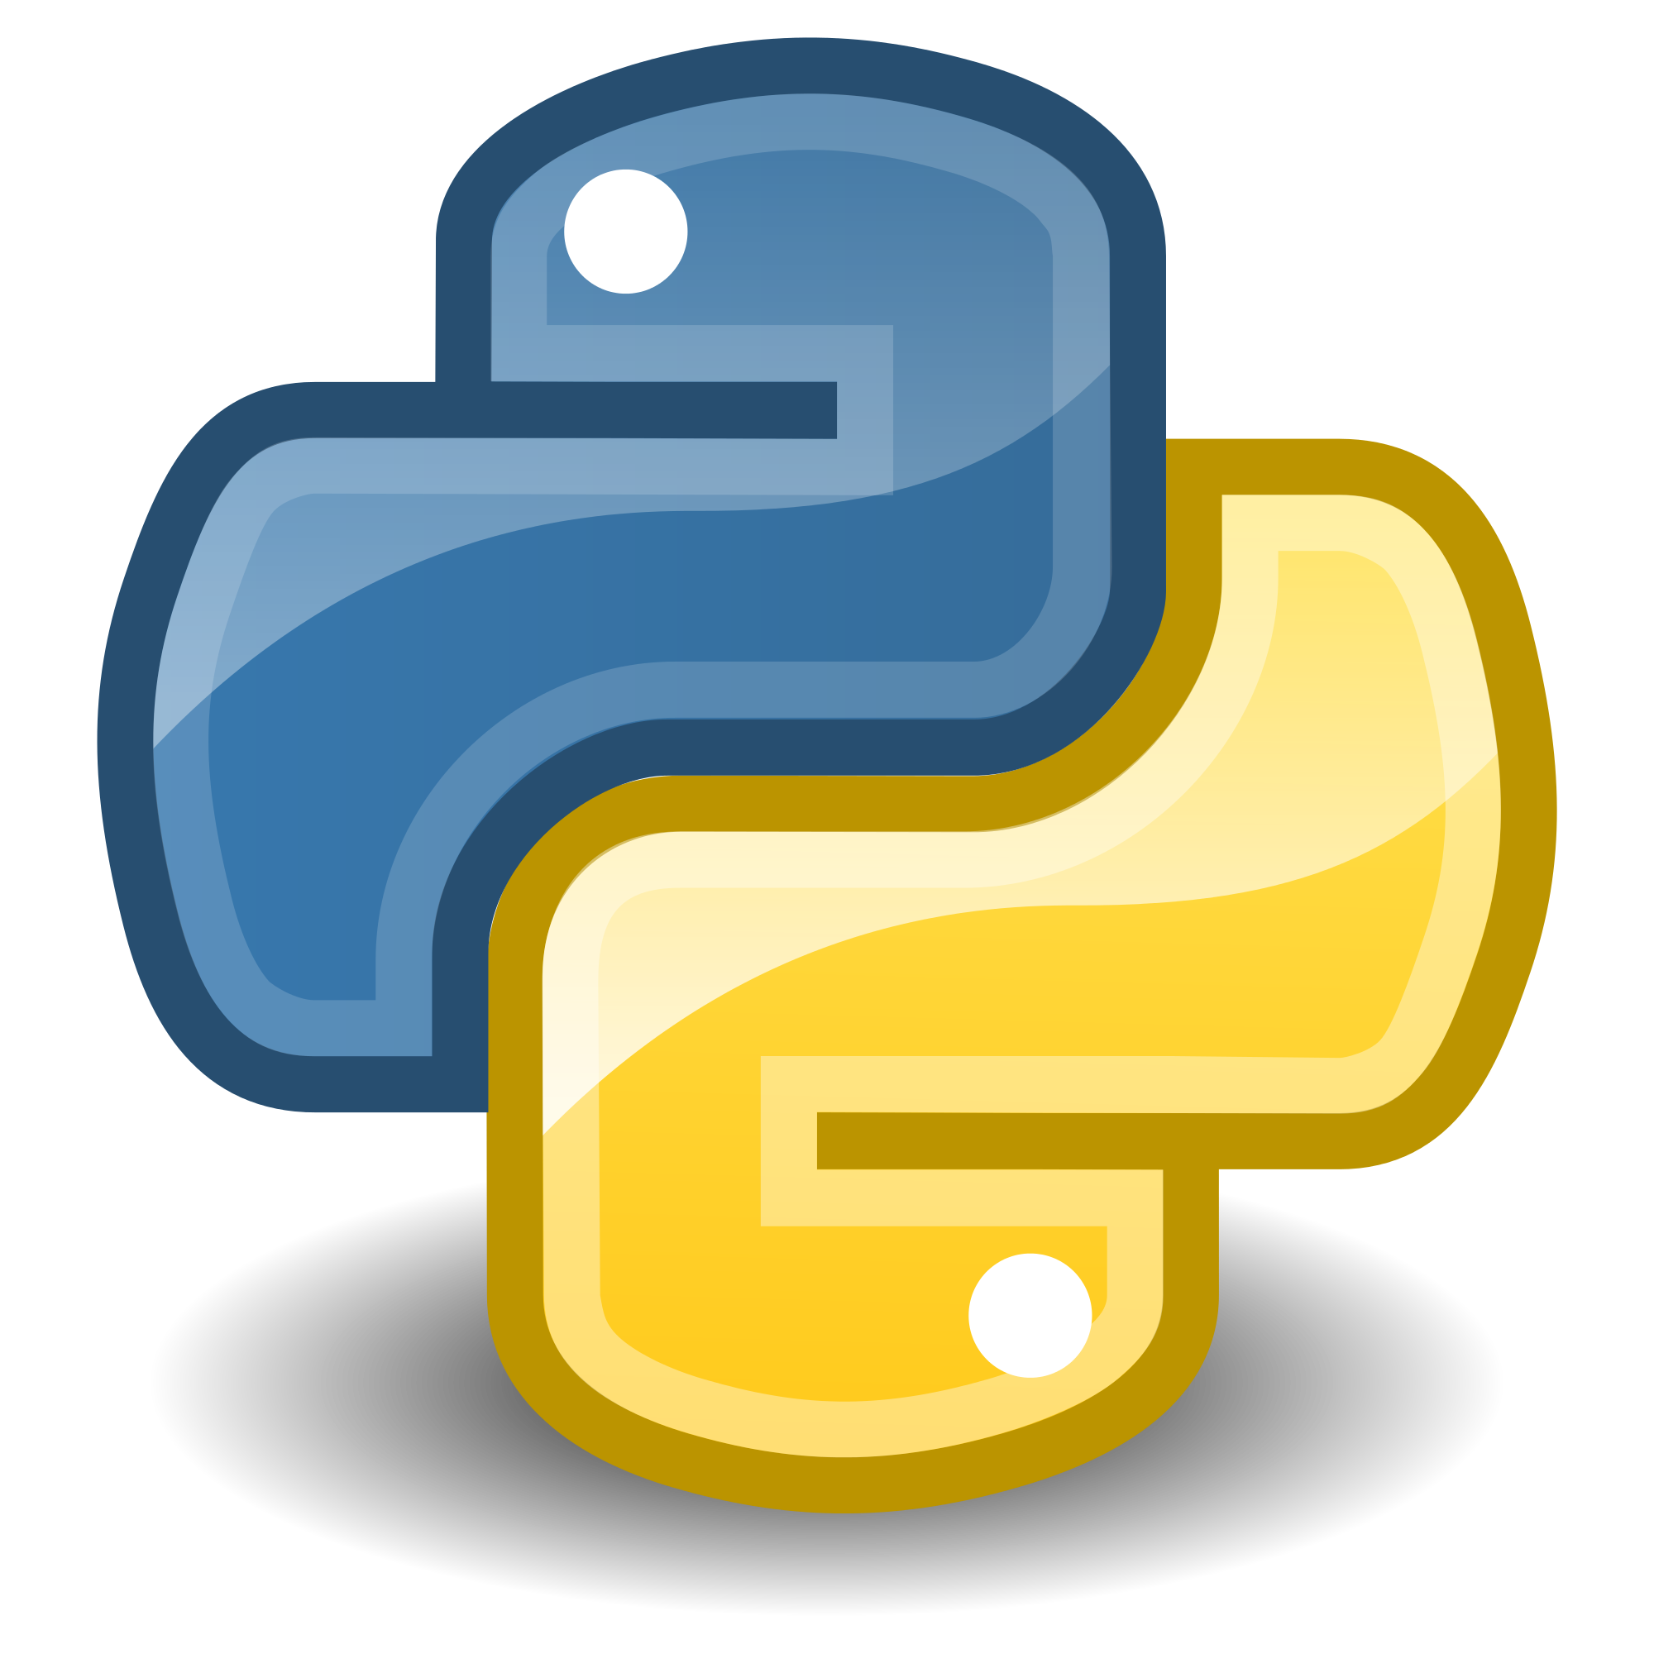
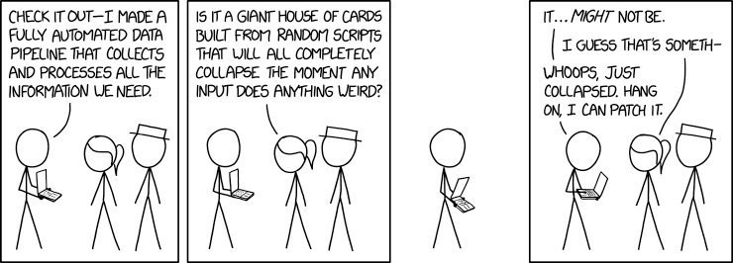
T. MANAssis Testing (A RAP python PERSPECTIVE)
Testing
What to test?
Manual Testing
Automated testing
Coverage
Property based testing
Continuous Integration (CI)
OR:
HOW TO USE SOFTWARE ENGINEERING PRACTICES for your data science
LIKE A BOSS

Slide 2



Essential / Nice to have / Deeper

Slide 3
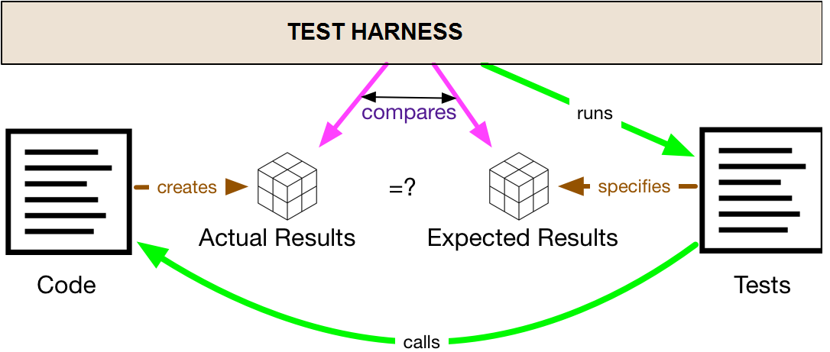
Testing
A program implements functionality, aka behavior.
Tests = supplementary code, that compares the actual behavior (from running the program) to the expected behavior (that’s coded into the test suite).
Your test harness is the framework that finds your tests, runs your tests, and (in theory) helps you write tests.

Slide 4


Testing II
If you hate your test harness, you will never enjoy writing tests. It’ll always be a slog, and you’ll avoid it whenever you can.
pytest is a good package for helping with testing in Python. It minimizes the friction involved in writing tests to as little as possible
testthat package works similarly for R

Slide 5
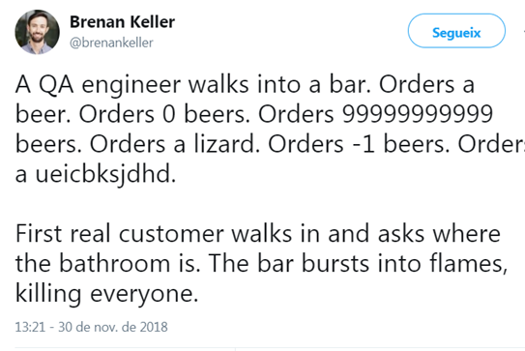
What to test?
- Sanity tests (eg. 1+1==2) . If this doesn’t work nothing will work ☺
- Unit tests (usually testing the result of a specific function)
Usually human-validated cases of function results from known parameters
Edge cases perhaps?
Useful to first create the test (that fails) and then code the function in a correct way so it can pass the test (Test Driven Development)
But this is kind of…AUTO_MANUAL / Anecdote based unit testing

Slide 6



What to test?
- Test the happy path
ensuring that when things go well the result is as it should be
Test the unhappy path :
Test that when things fail they fail gracefully and under control
Error handling
Exceptions
What do you mean you don’t use exceptions

Slide 7
Pytest
Easy to use
Can run already existing tests in other python testing frameworks such as unittest
With minimal or no changes!
Approachable basic functionality:
assert overloaded so… only one command to remember
for more advanced usages there are plugins to help:
Xdist = run concurrently many tests (if your code allows it)
Timeout = fail a test if it takes more than xyz minutes/seconds
Faker = integrate faker package for creation of synthetic/fake data for your tests
Many more

Slide 8
But will I need all this testing as a data scientist?
You definitely need to unit test the functions you are creating.
You don't need to test everything under the sun.
Just your functions
(that is functions that you think are going to be run many times by you or people in your team)
Don’t test functionality tested elsewhere
(ie scikit-learn has its own tests don’t reinvent the wheel)
But If you create a function that does something in a scikit learn pipeline test that!)
Great example here: https://www.chrjs.io/engineering-for-reproducibility/
Do lots of unit tests.

Slide 9

RECAP I
So. To Recap: You definitely need to unit test the functions you are
UNLEASHING INTO THE WILD.

Slide 10
Automatic testing I (basics)
- py.test parameterize / fixtures for unit tests
- Fixture functions can be parametrized in which case they will be called multiple times, each time executing the set of dependent tests
- Test functions usually do not need to be aware of their re-running.
- Fixture parametrization helps to write exhaustive functional tests for components which themselves can be configured in multiple ways

Slide 11
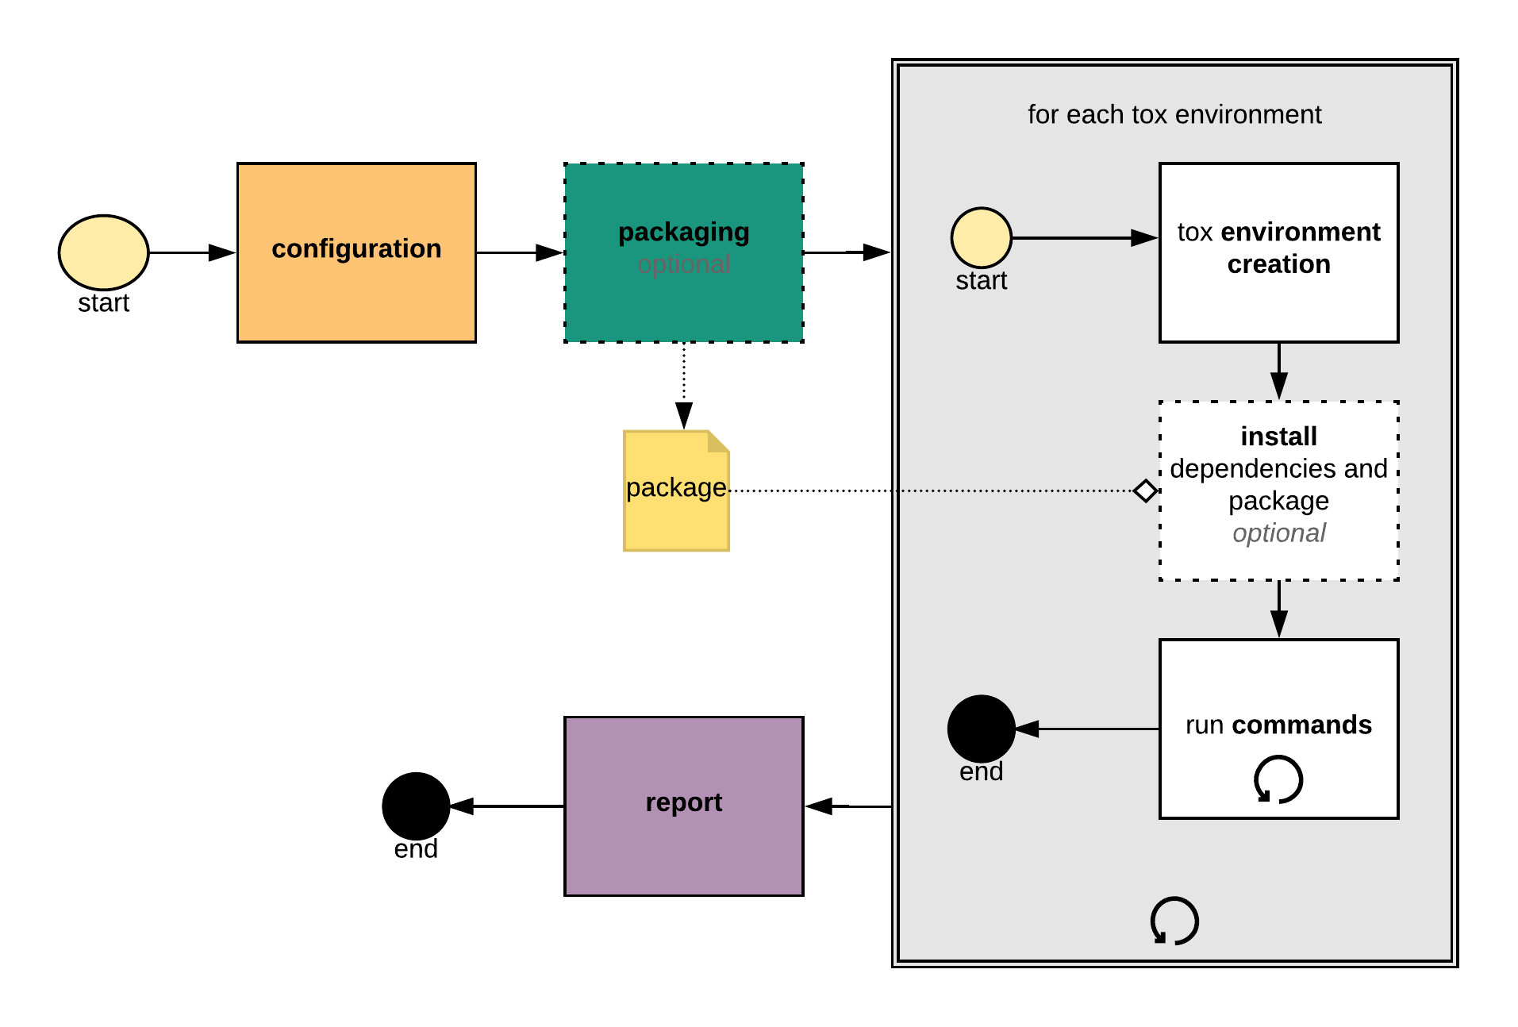
Automatic testing: environments
- tox / nox for automating environments
ie. Ok it works on my machine but does it work on:
Python 2.7+,3.3,3.4,3.5,3.6 ?
On both Win and Linux Based systems?
Already 10 combinations of envs
Tox/nox automate this for example
envlist={py27,py33,py34,py35,py36}-{windows,linux}

Slide 12
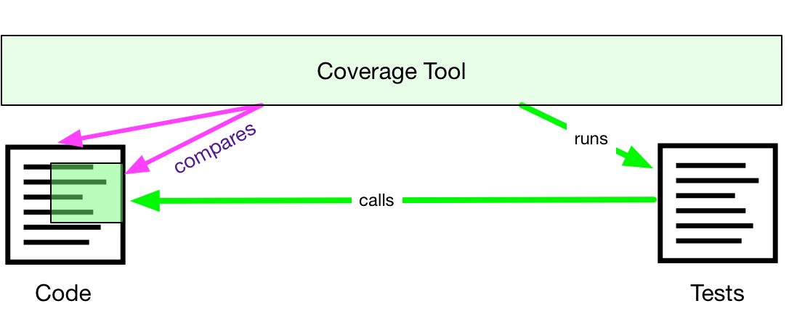
Code/Test Coverage
Some parts of your code end up being tested, some don’t.
Code coverage (or test coverage) is a measure of how much of your code is executed by tests.
A code coverage tool runs your test suite against a logged version of your program, and reports its coverage.
Pytest can get this functionality thru a coverage plugin
You can always setup your coverage tool to ignore certain parts that you don’t want to test.

Slide 13
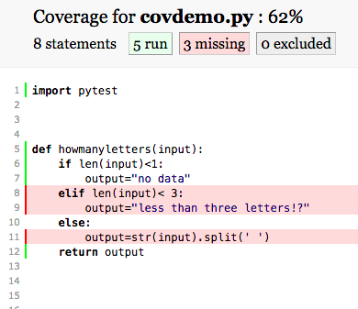
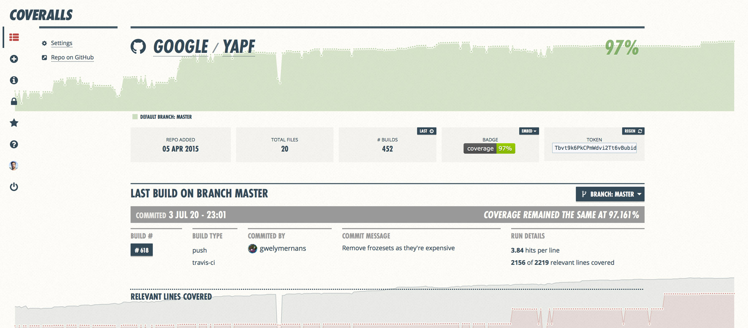
Code/Test Coverage
https://mamonu.github.io/testing_coverage/
A blog post with a simple pytest example that also creates an html coverage report in html format
Ways of integrating cover reports on github:
https://coveralls.io/
https://codecov.io/

Slide 14
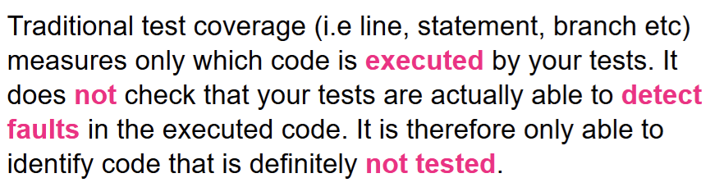
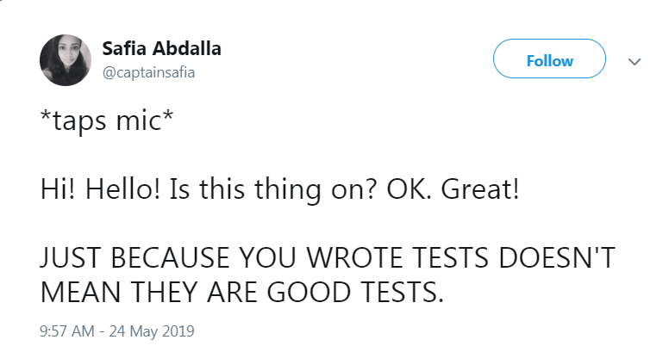
“Covered” doesn’t mean “well tested”

Slide 15
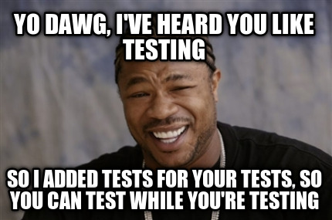
“Quis custodiet ipsos custodes?”
Latin. It translates to “but who will guard the guardians??”
How can you be sure that your testing is adequate? PBT
In example-based unit tests you:
define some example inputs
define the expected results
you run your code and check that they match!

Slide 16
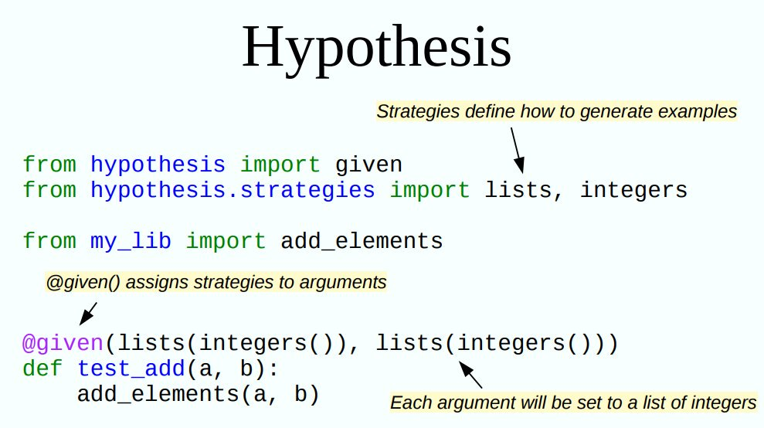
Automatic testing III (PBT) in python
- hypothesis module
Property Based Testing:
Describe the input
Describe the properties of the output
Have the computer try lots of random examples – check they don’t fail
Availiable as a pytest plugin
https://mamonu.github.io/Property-Based-Testing/

Slide 17
Automatic testing III (PBT) in R
- hedgehog library

Slide 18
Property based testing
A bit more involved
Writing good properties can be hard
Writing good generators can be even harder
PBTs are more general
One property-based test can replace many example-based tests.
PBTs can reveal overlooked edge cases
Nulls, negative numbers, weird strings, etc.

Slide 19

Sidenote: Mutation Testing
Mutation testing involves modifying a program’s source code or byte code in small ways.
A test suite that does not detect and reject the mutated code is considered defective.
These so-called mutations, are based on well-defined mutation operators that either mimic typical programming errors (such as using the wrong operator or variable name) or force the creation of valuable tests (such as driving each expression to zero).
The purpose is to help the tester develop effective tests or locate weaknesses in the test data used for the program or in sections of the code that are seldom or never accessed during execution.
Related Python packages :
mutpy / mutmut / cosmic_ray (recommended)

Slide 20
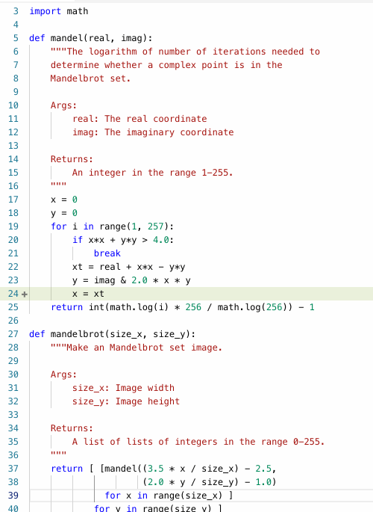
Sidenote: Mutation Testing
Mutation testing involves modifying a program’s source code or byte code in small ways.
A test suite that does not detect and reject the mutated code is considered defective.
Currently experimental, academic
But its good to think outside the box

Slide 21
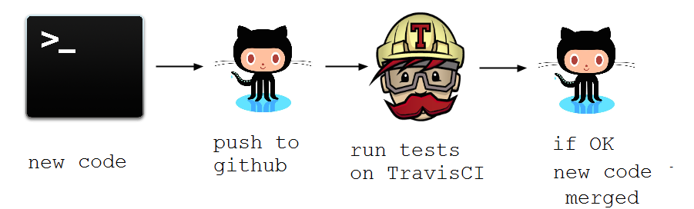
Continuous Integration
Every time someone tries to integrate / add code to a codebase the following things need to happen:
merge new code with old code in a test environment
run a series of tests
if none of the tests is throwing an error code review can take place
…Then merge

Slide 22

Automatic testing / CI: Dockerizing environments
create your test environment on a Docker container
copy your code to that docker container
test …locally or in cloud
Useful when you are working in complex environments (like say the MOJ AP) that you don’t want to mess up but you really need to test
E.G testing things in spark
Github actions https://github.com/features/actions
Live Example for testing python : https://github.com/mamonu/gh_Actions_CI_py
Example for testing pyspark (more involved so not live)

Slide 23

Unit testing…the end?

Slide 24
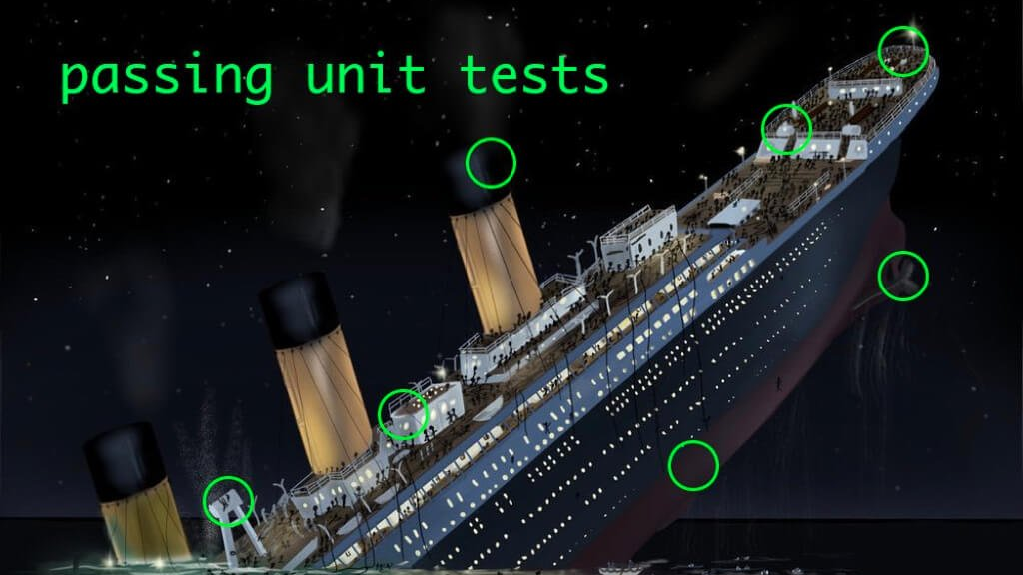

Slide 25
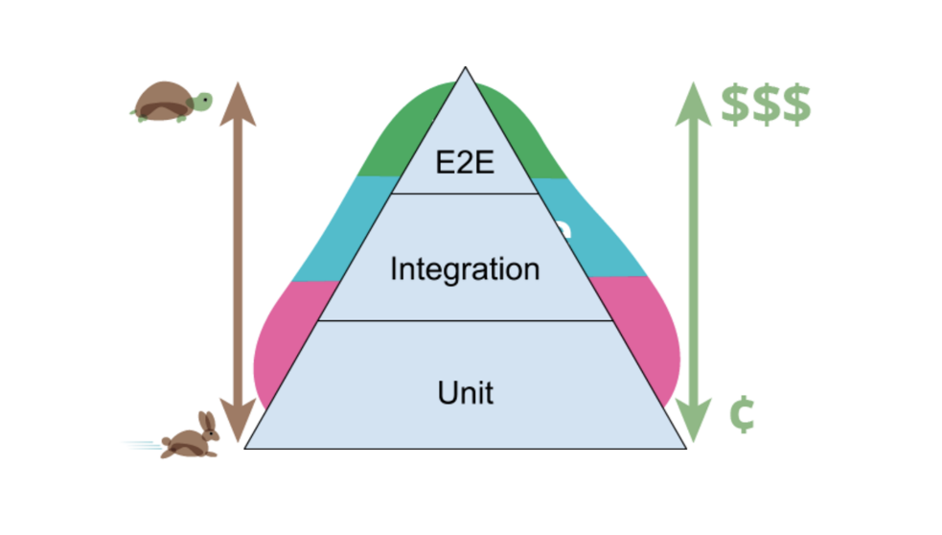
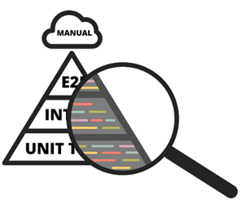
Unit tests are not enough.
Also need integration tests as well to test how different functions / systems work together.
End-to-End tests are useful too.
This kind of testing is very useful for the Reproducible Analytical Pipelines we are trying to help construct.

Slide 26
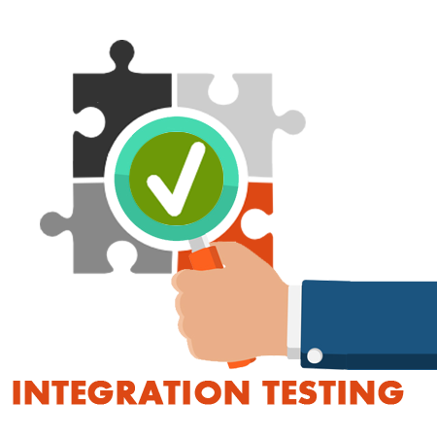
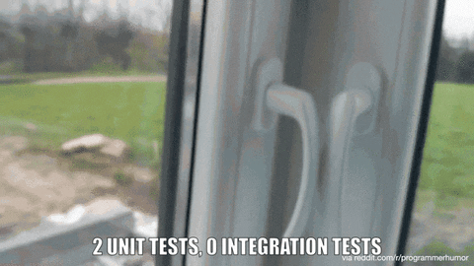
Integration Testing
Integration testing: Testing performed to expose defects in the interfaces and in the interactions between integrated components or systems.
(… systems such as Reproducible Analytical Pipeline steps !!!!)

Slide 27
Integration Testing
Need integration tests across the whole stack,
But fewer,
Only to find integration issues, not subsystem level functionality issues.
Needed after each subsystem has been validated in isolation.
This ensures that integration tests will find integration issues.
There may still be emergent issues when the whole stack is used together * hence E2E testing needed
But if each subsystem has been validated in isolation, then any integration bugs are just that; due to integration, not any of the subsystems.

Slide 28
Testing for RAP Pipelines
unit tests
my
reproducible
pipeline steps
integration tests

Slide 29

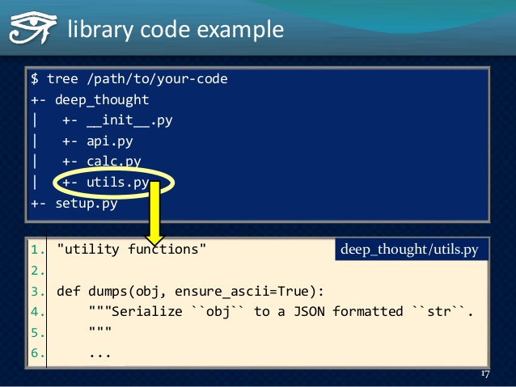
Code Auto-Documentation
SPHINX (autodoc) in Python
Can take docstring comments in function code as input
You can define input parameters and output and include and preferably an example.
Many outputs (HTML/PDF/LaTeX)
Example can be taken from test or test from example

Slide 30
An example of a workflow
Pull latest code from repository
create a branch. Have created new functions there? Write unit tests for them.
Pushing to github on a branch of a project.
All unit tests are run (including ones just created)
Did they pass? Great. Onwards
Code review
merge to master branch
Here is where integration / end to end tests are more useful
You can make it so that additional tests (integration/E2E) run only here in addition to the unit tests
Do tests pass? Great. Onwards
Code review

Slide 31
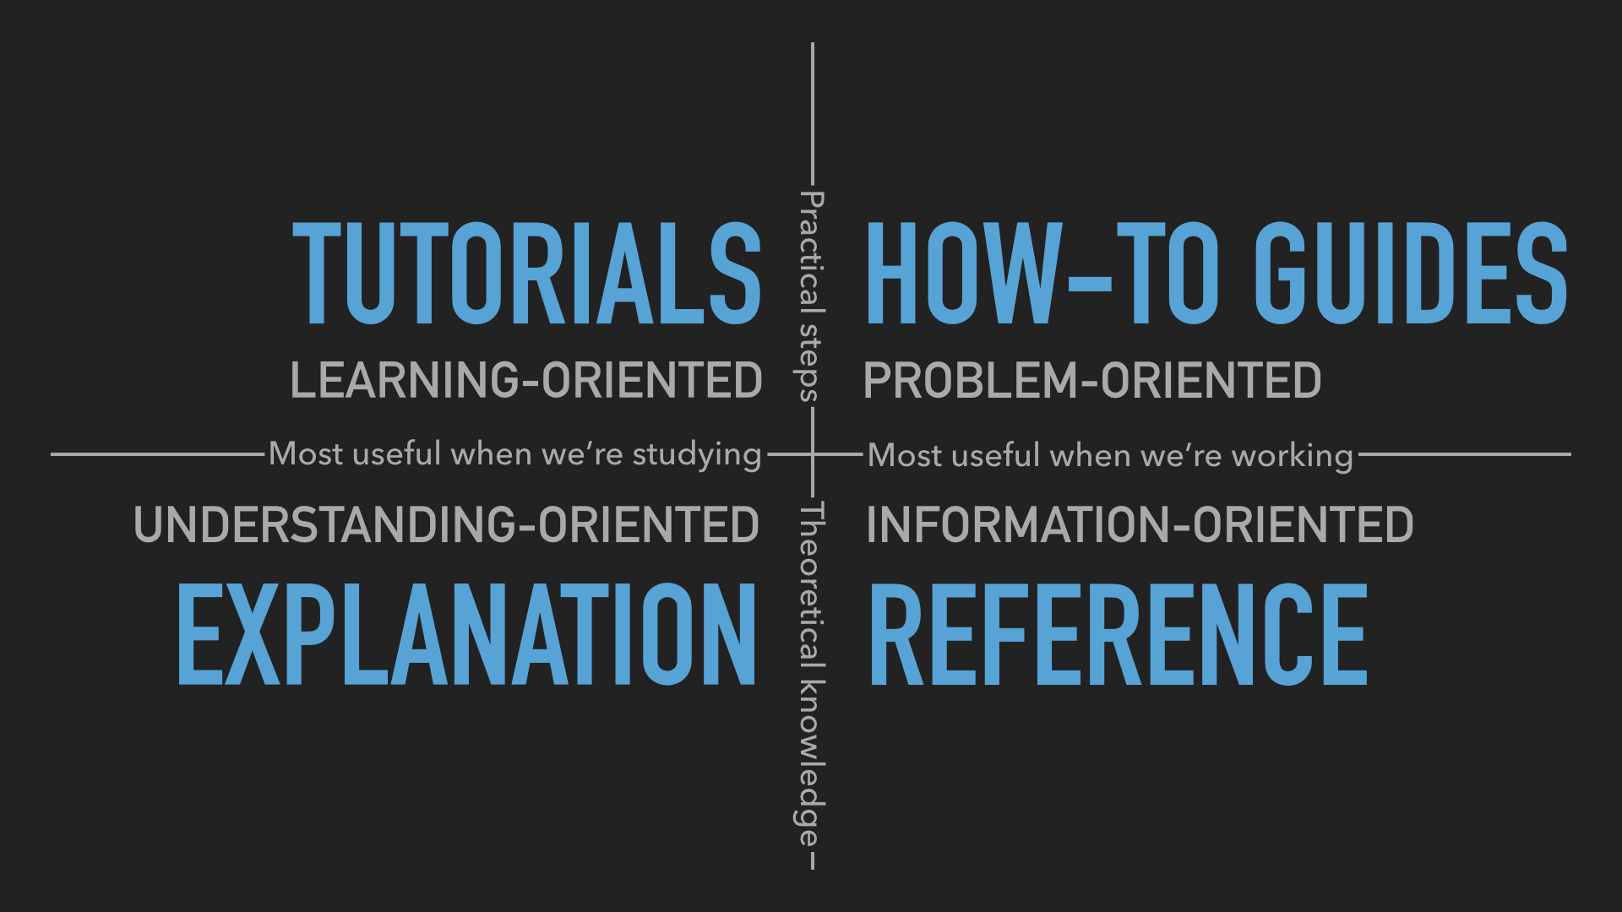
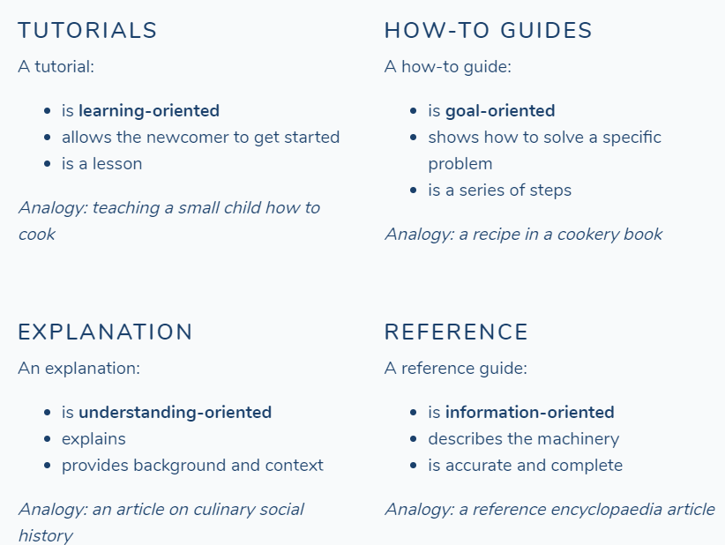
Documentation
Taken from:
https://www.divio.com/blog/documentation/
Please have a look for elucidating the concepts if interested

Slide 32
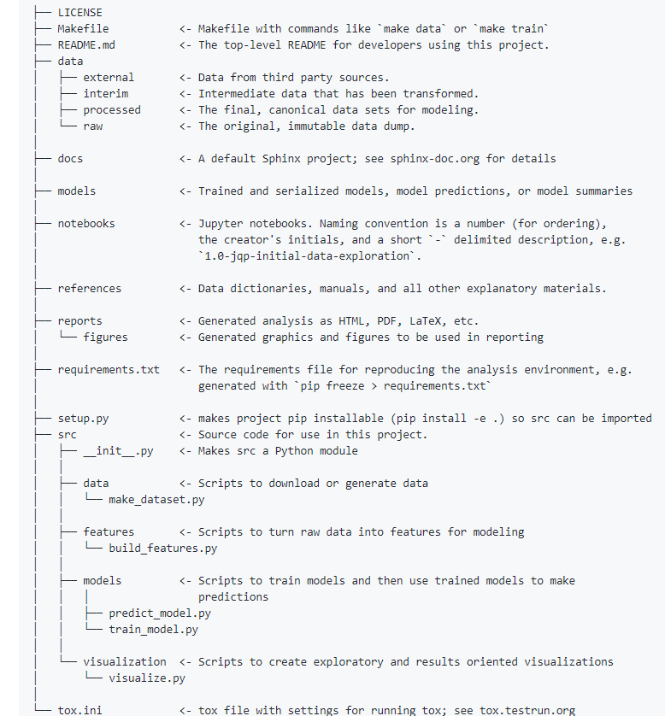
Project organization
Do not reinvent the wheel regarding how you organize the code for your project:
Python: cookiecutter
R:
https://github.com/bdcaf/cookiecutter-r-data-analysis

Slide 33
References and material of interest
- Some Books of interest :
https://certifications.bcs.org/upload/pdf/swt-intermediate-reading.pdf
https://www.oreilly.com/library/view/python-testing-with/9781680502848/
- Blog Posts
https://martinfowler.com/articles/practical-test-pyramid.html
https://hypothesis.works/articles/
https://docs.pytest.org/en/latest/
https://medium.com/homeaway-tech-blog/write-better-python-with-hypothesis-5b31ac268b69
https://mamonu.github.io/
- Course
Great course covering the spectrum of tools from the R side of things:
https://www.udemy.com/reproducible-analytical-pipelines/
- Covered /useful Python modules:
py.test : https://github.com/pytest-dev/pytest
mutpy/mutmut/cosmic_ray
hypothesis : https://github.com/HypothesisWorks/hypothesis
tox / nox : https://github.com/tox-dev/tox
cookiecutter: https://github.com/audreyr/cookiecutter
pyjanitor : https://github.com/ericmjl/pyjanitor
Article : When RAP processes are not there…..
https://www.bbc.co.uk/news/magazine-22223190

Slide 34
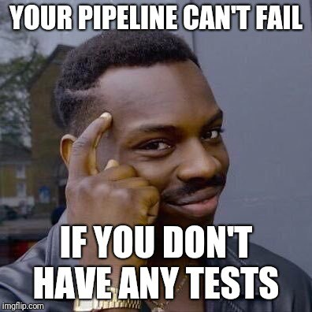
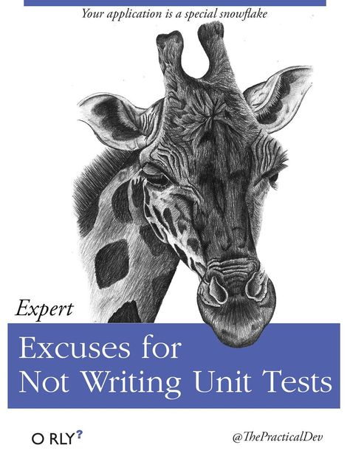

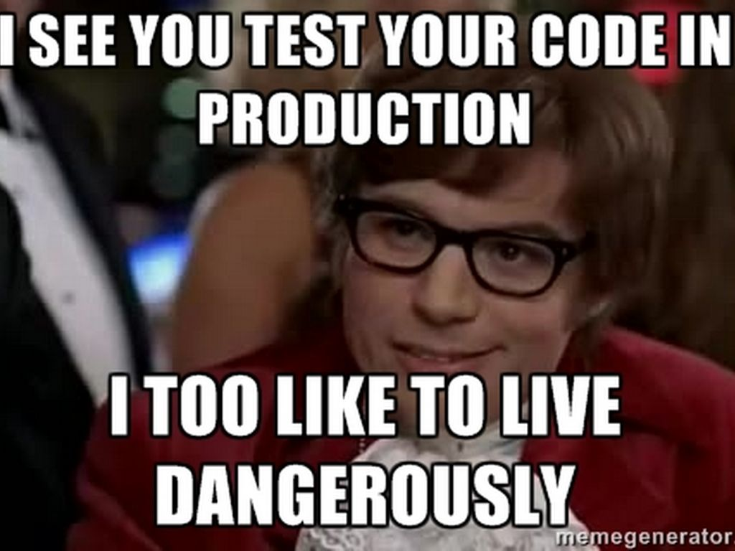
Obligatory MEMES!

